Slide 1


Introduction to GitHub
Armando Antonio

Slide 2

Agenda
What is GitHub?
Create a Repositori
Clone Repository from GitHub
Git Remotes (List, Add, Manage Multiple Remotes)
5. Search Files
Navigate Repository Files/Folders
Edit File within GitHub
Branch Commit History
Trace File History (Blame)
Create a Pull Request
Insert Unit Tests Screenshots
PR Conversation Tab
Review a Pull Request
Comments and Suggested code

Slide 3
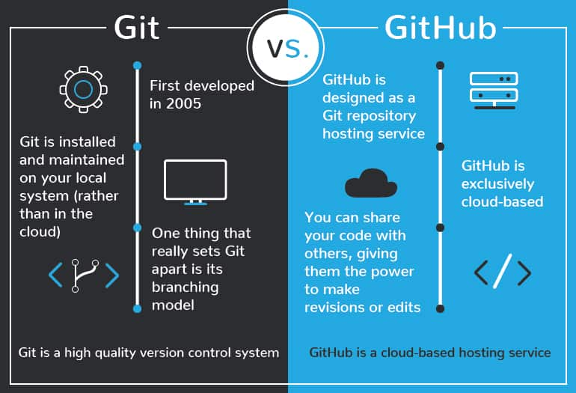
1. What is GitHub?
It is a cloud-based platform and service for software development and version control using Git, allowing developers to store and manage their code.
It provides the distributed version control of Git plus access control, bug tracking, software feature requests, task management, continuous integration, and wikis for each project.
Other servers GitLab, BitBucket, etc.
Version Control System
Distributed
Key commands like commit, push, pull, branch and merge
Hostin Platform.
Collaboration.
Integration.

Slide 4
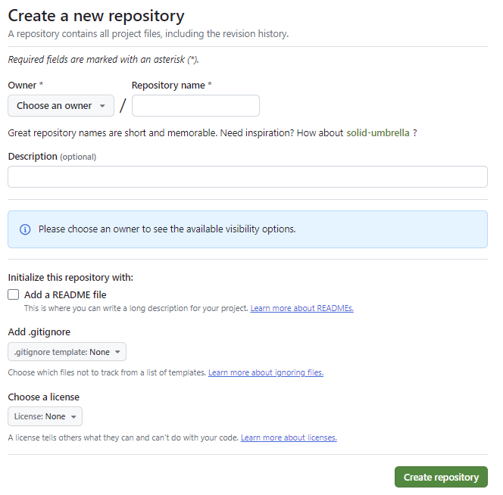
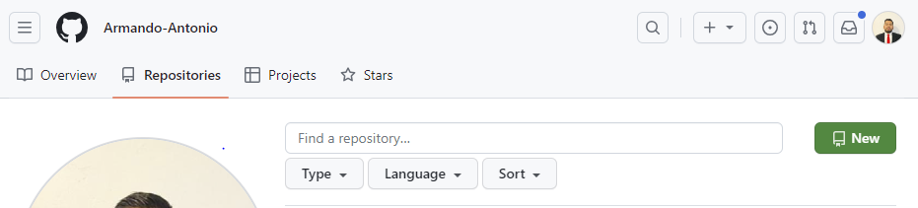
2. Crear a Repositorio
Steps
Click on “New” in the repositories section.
Enter repository name and description.
Choose visibility (public/private).
Initialize with a README (optional).
Naming Convetions repo projects: lowercase and dashes pattern:
star-wars.git
the-empire-strikes-back.git
return-of-the-jedi.git
It provides an overview of the project, installation instructions, usage guidelines, contribution protocols, and contact information.
You can configure Git to ignore specific files, ensuring that the files listed in this document are not tracked by version control.

Slide 5
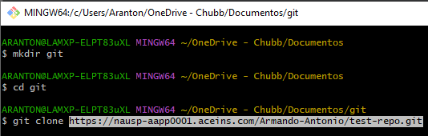
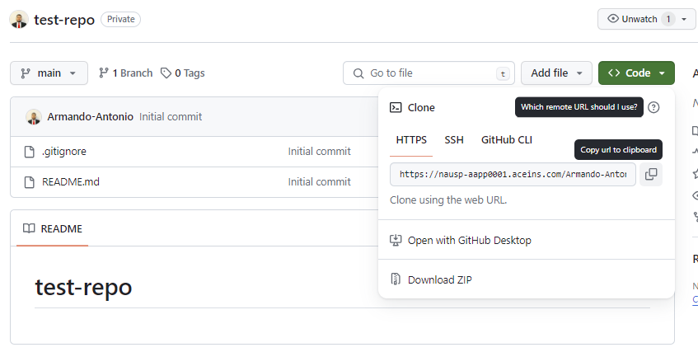
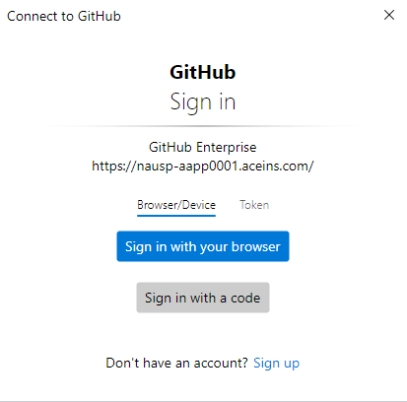
3. Clone Repository from GitHub
Steps
Copy the repository URL.
Use git clone <URL> in your terminal.

Slide 6
4. Git Remotes (List, Add, Manage Multiple Remotes)
Command | Description
git remote -v | Lists all the remote repositories associated with your local repository.
git remote add origin <URL> | Adds a new remote repository to your local repository.
git remote origin <name> | Removes remote repository from your local repository.

Slide 7
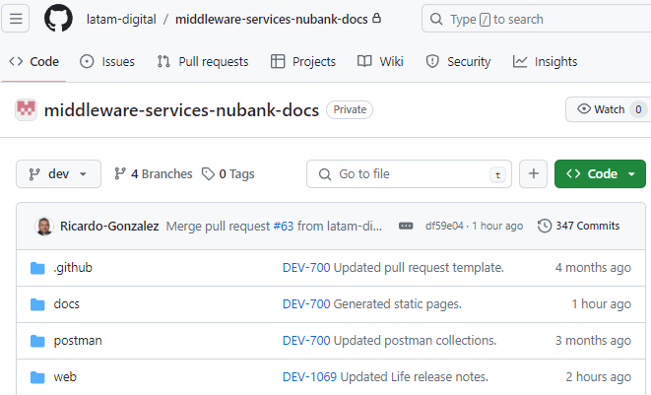
5. Search Files
GitHub Interface: Use the search bar at the top of the repository page.
Command Line: Use git grep <search-term>. Is used to search for a specific term within your Git repository through all the files and display the lines containing it.
6. Navigate Repository Files/Folders
GitHub Interface
7. Edit File within GitHub
GitHub Interface:
Navigate to the file.
Click the pencil icon to edit.
Make changes and commit.

Slide 8
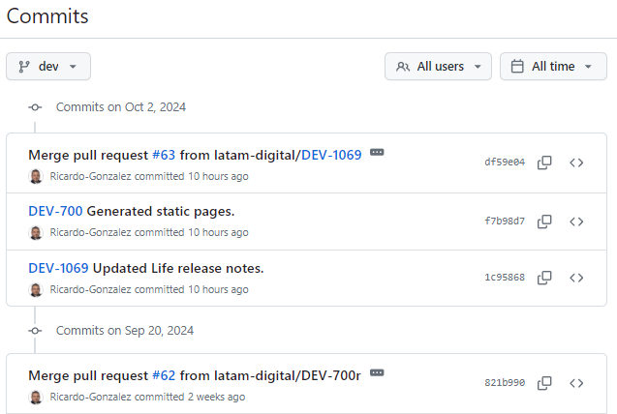
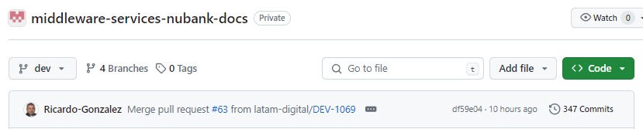
8: Branch Commit History
View History
On GitHub: Go to the “Commits” tab.
Command Line: git log

Slide 9
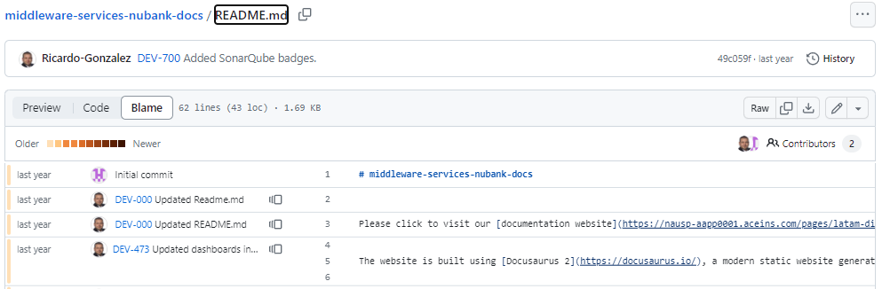
9: Trace File History (Blame)
GitHub Interface: Navigate to the file and click “Blame”.
Command Line: git blame <file-name>

Slide 10
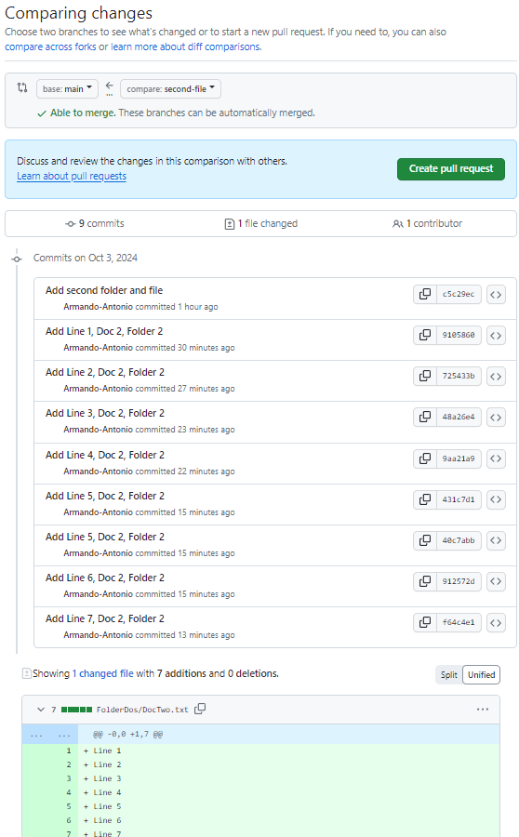
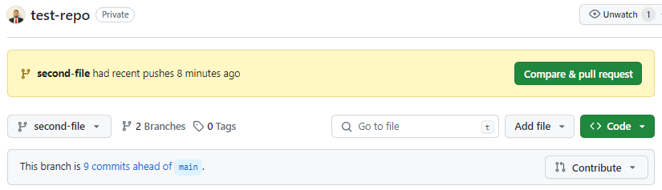
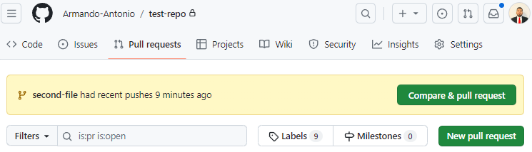
10: Create a Pull Request
Navigate to the repository.
Click “New pull request”.
Compare changes and create the PR.
PR Files Tap:

Slide 11
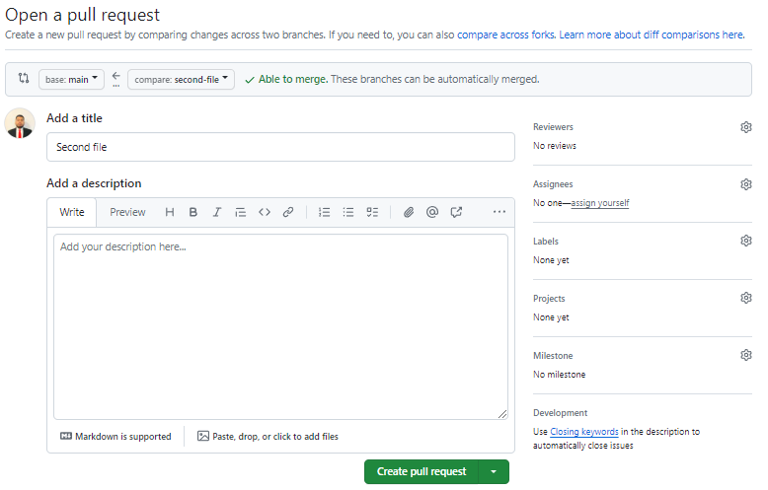
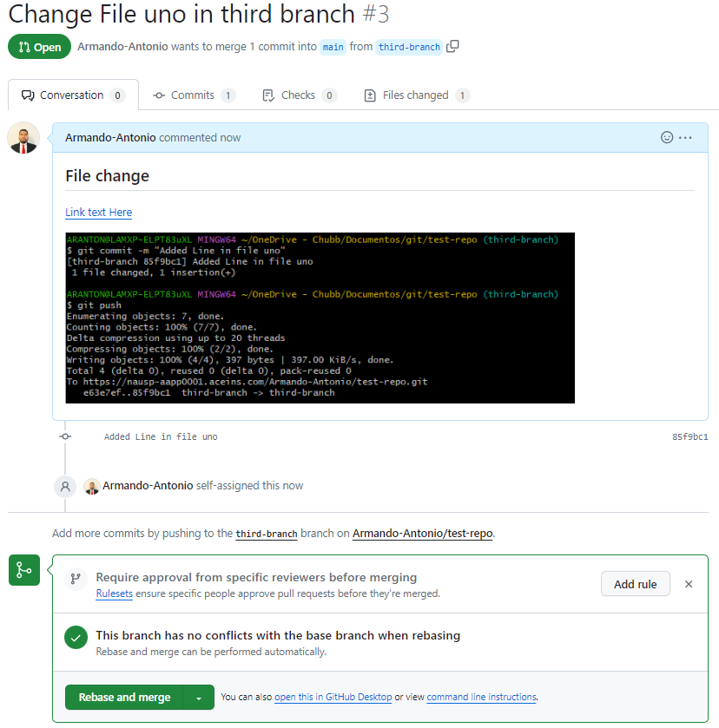
11. Insert Unit Tests Screenshots
Take a screenshot of your unit tests.
Attach the screenshot in the PR description or comments.

Slide 12
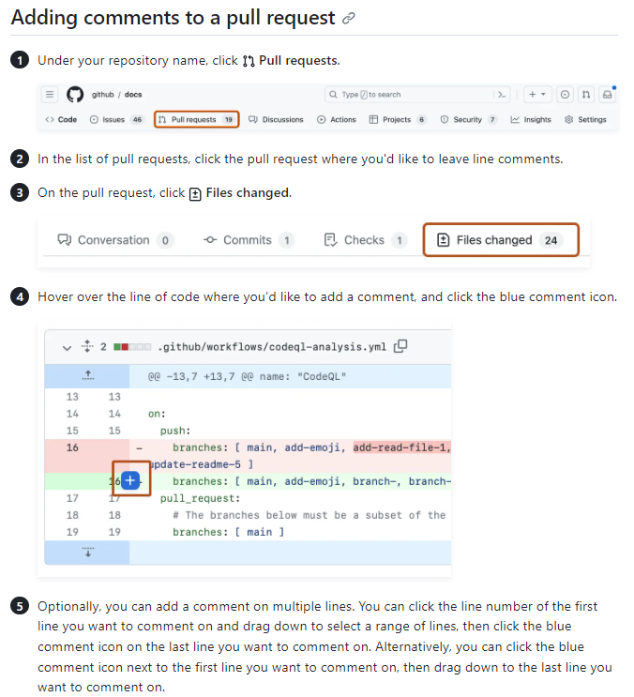
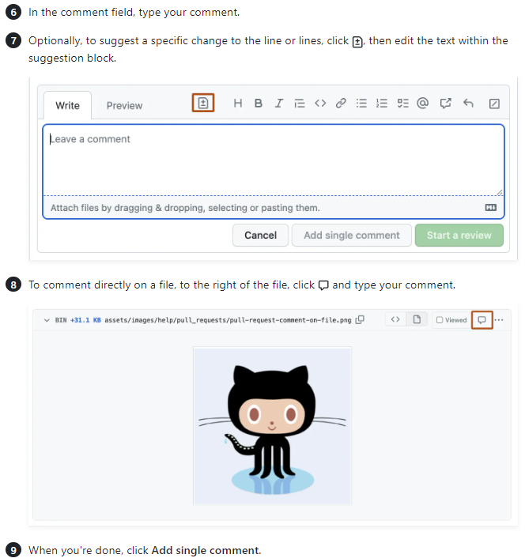
12: PR Conversation Tab

Slide 13
13. Review a Pull Request

Slide 14
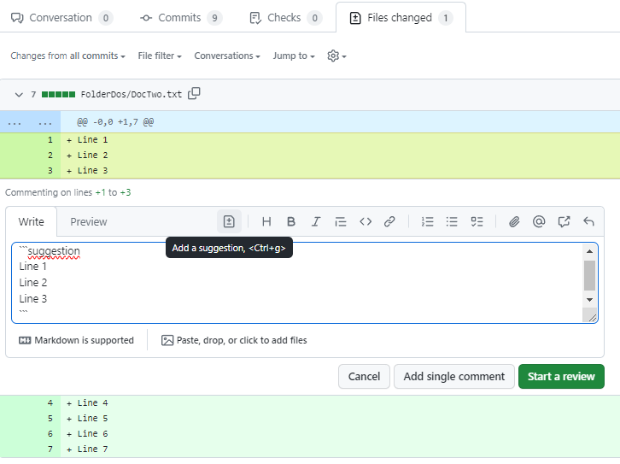
14. Comments and Suggested code

Slide 15


Thanks! :D

